Slide 1
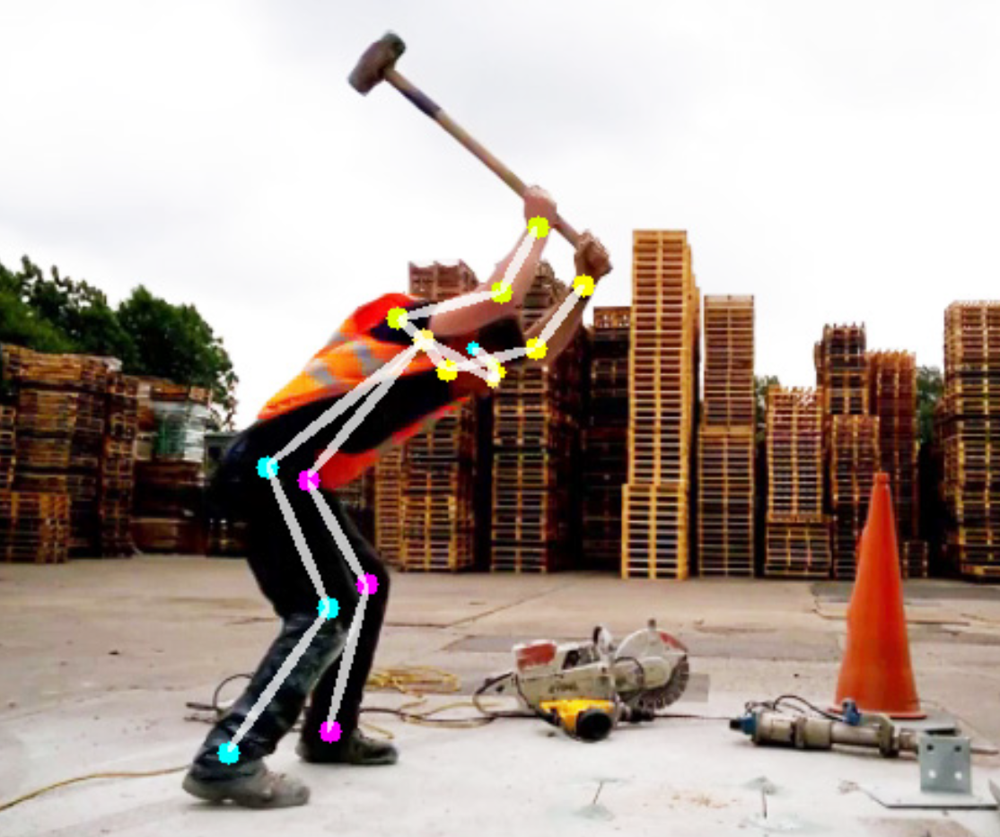
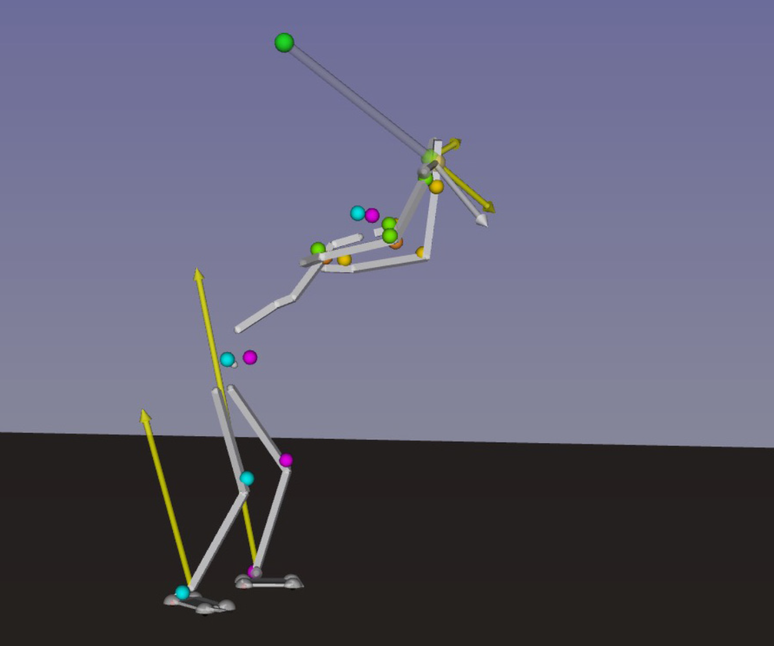




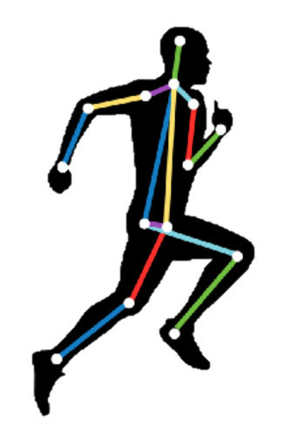


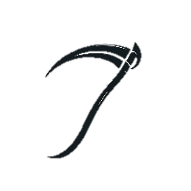
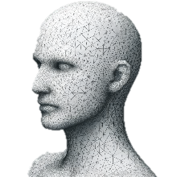


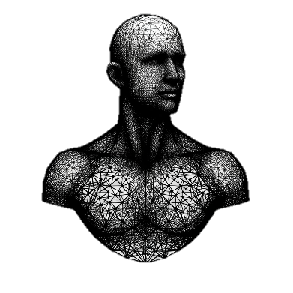
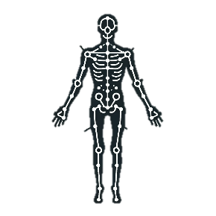




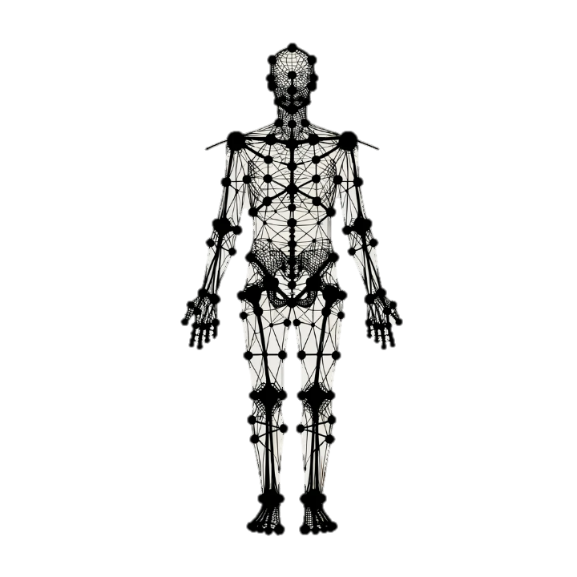
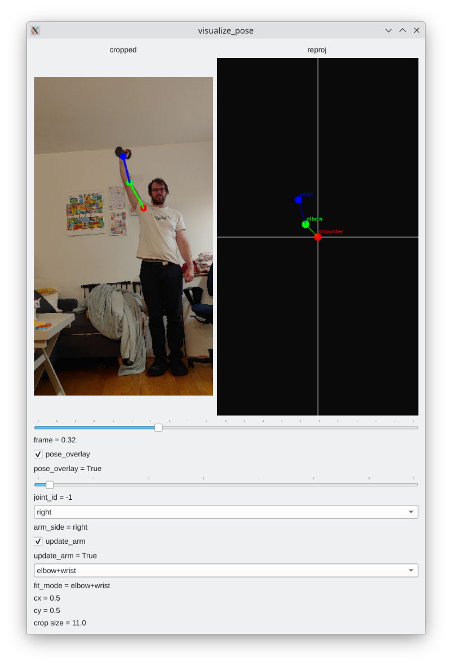

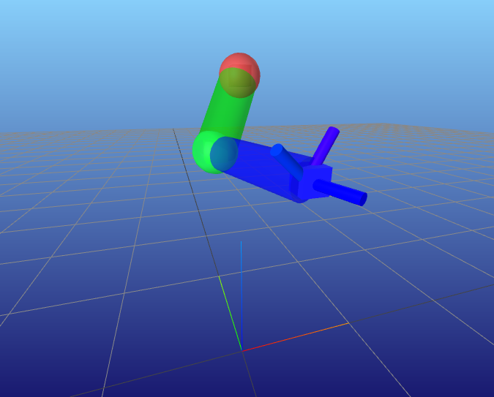

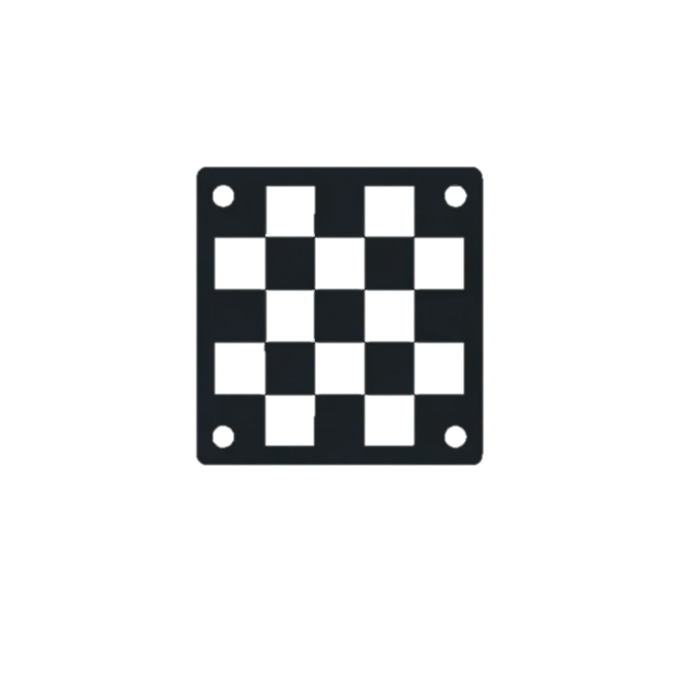
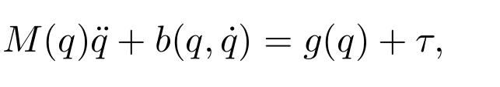

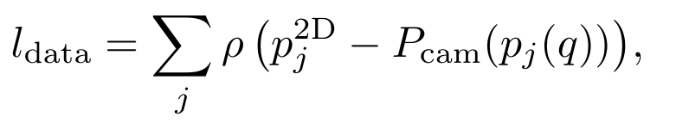
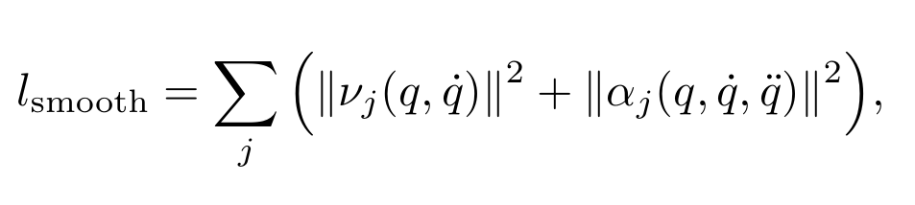

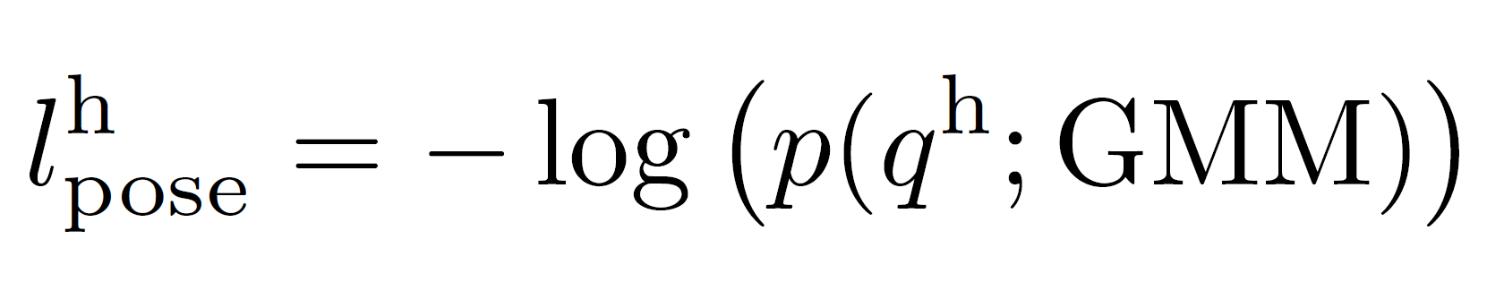
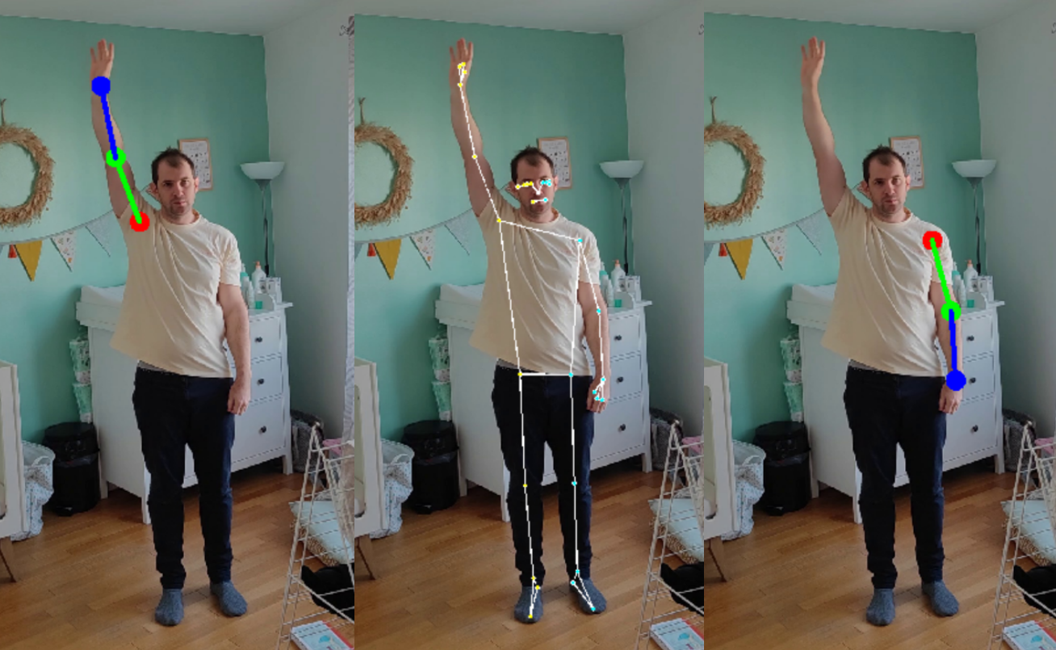
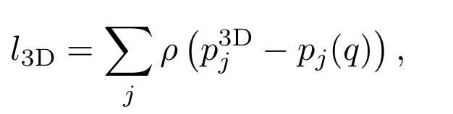
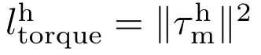
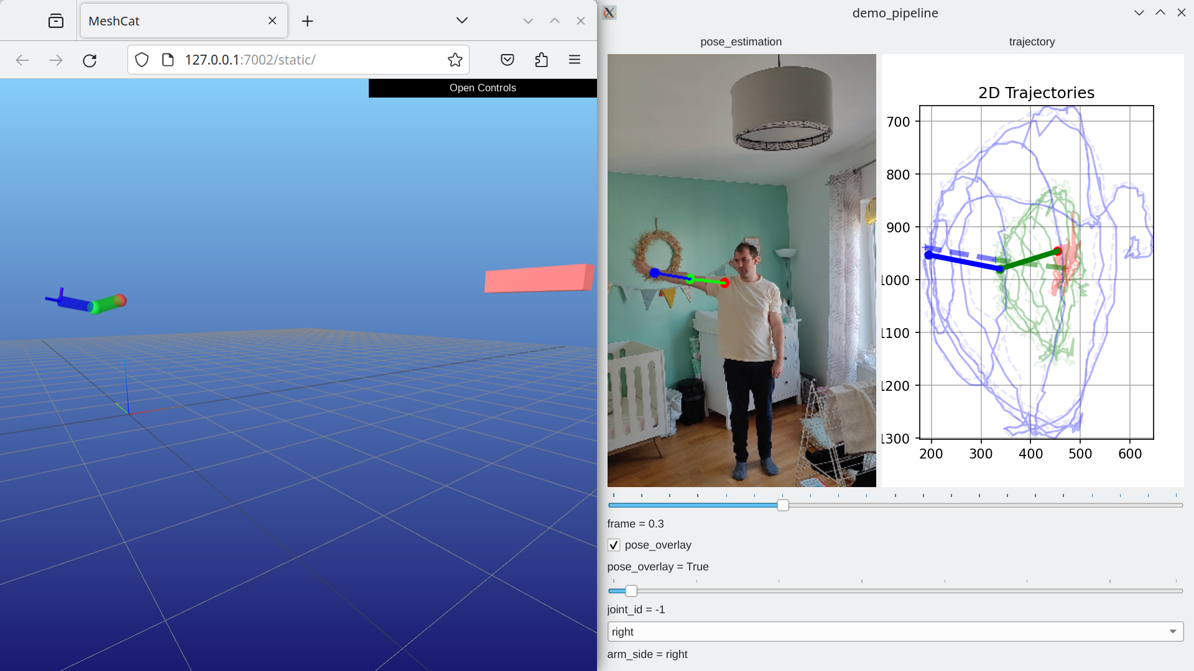
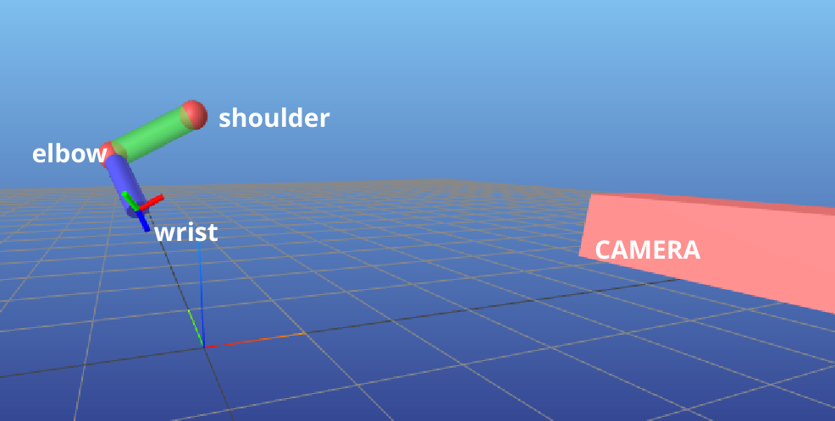
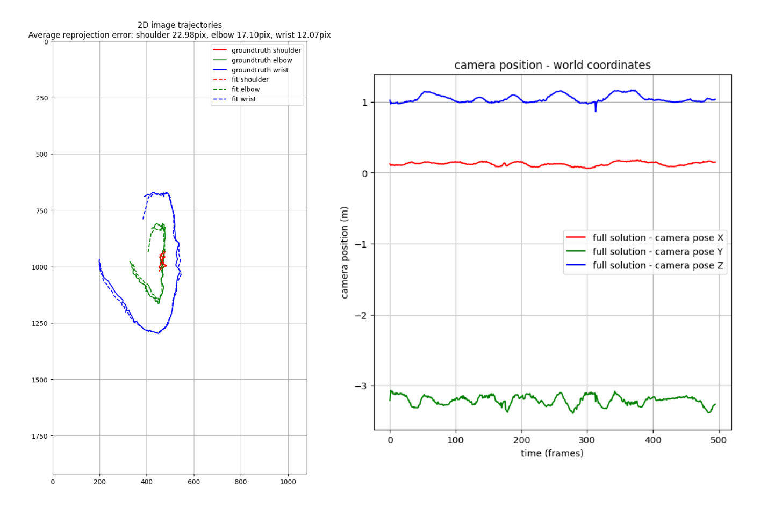
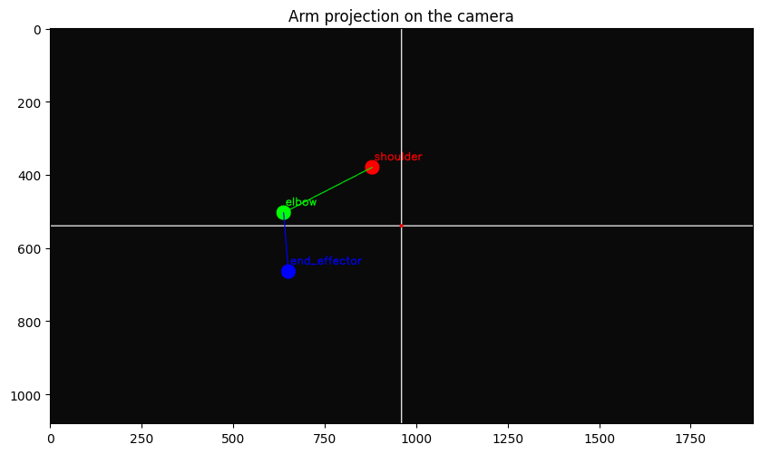
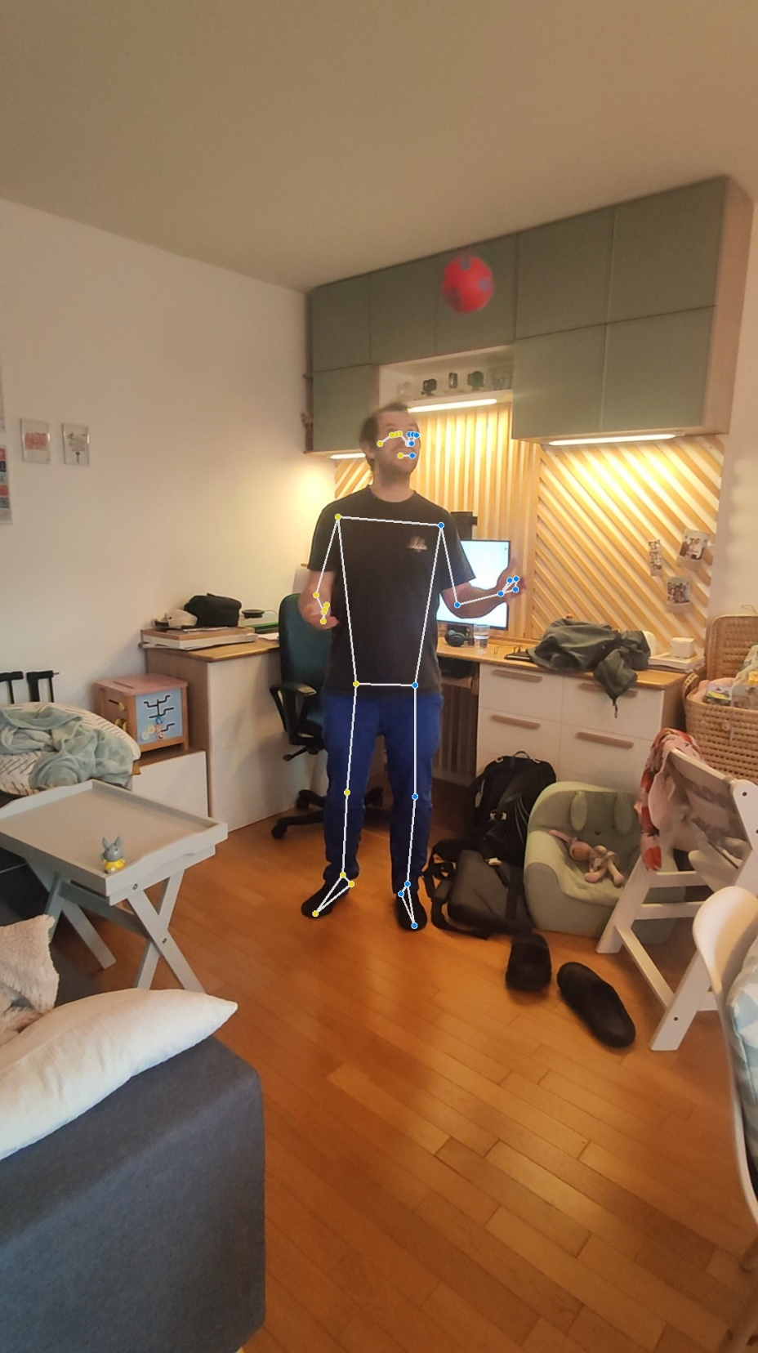
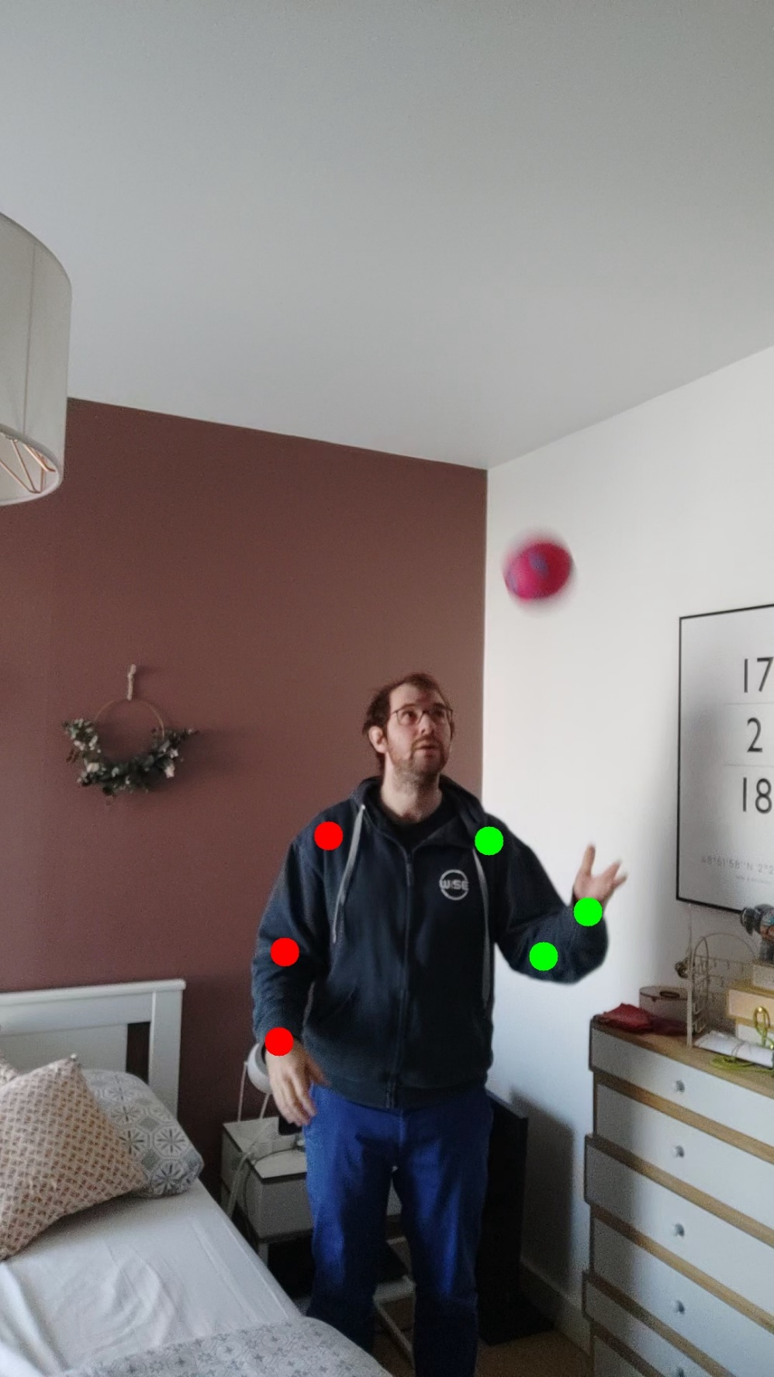
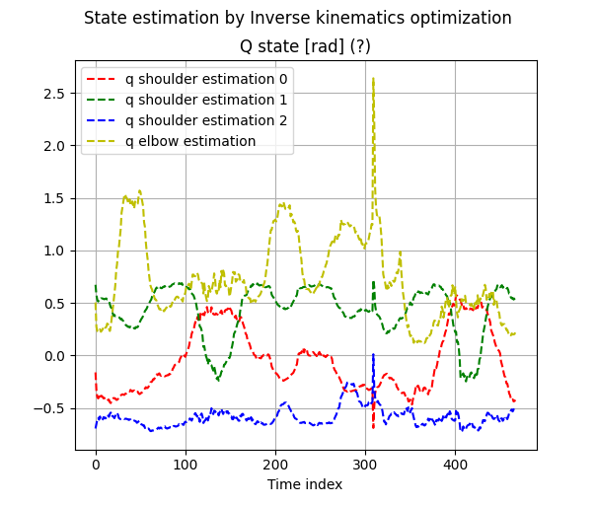



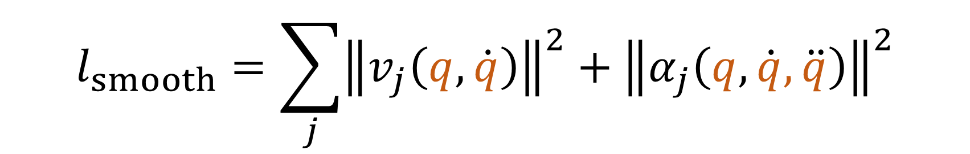
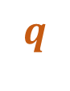
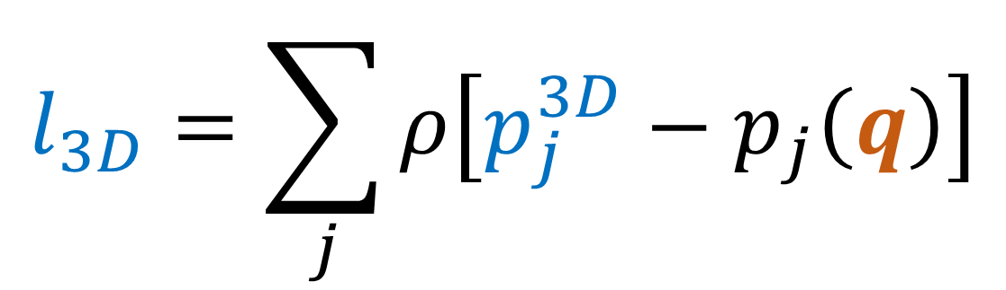
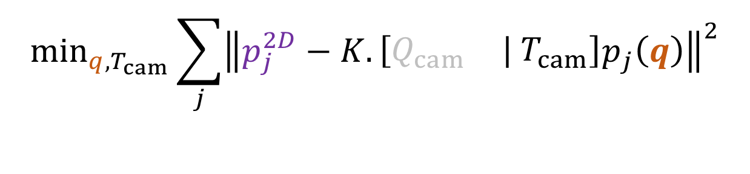
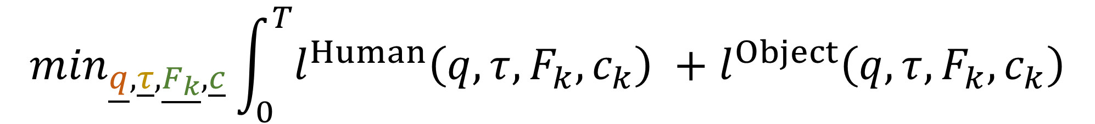
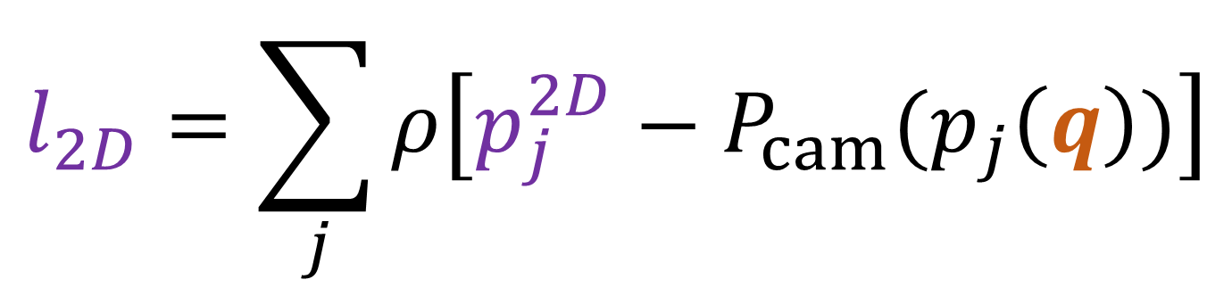
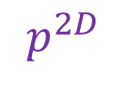


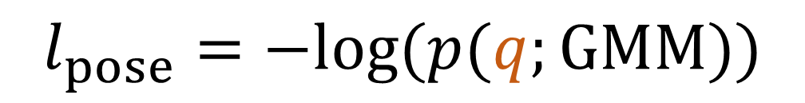
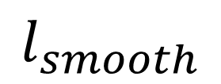
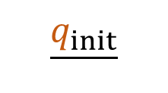
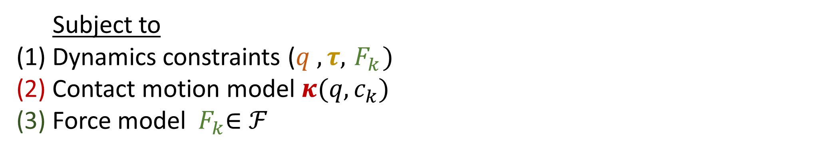
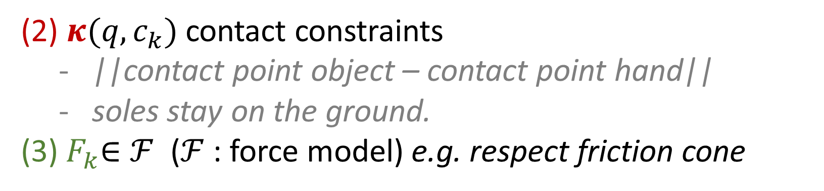
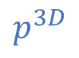
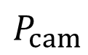

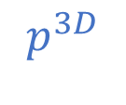
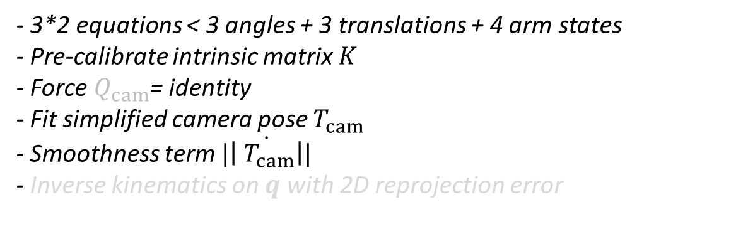
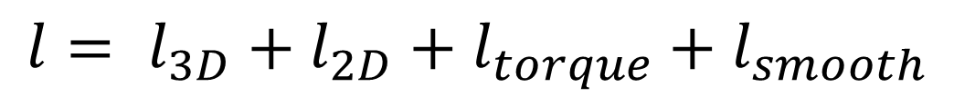

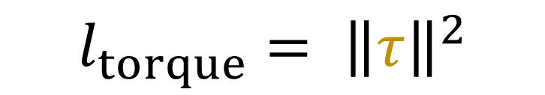
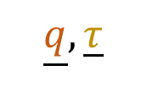
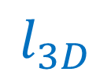
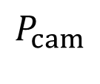
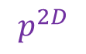
Estimating 3D Motion and Forces of Person-Object
Interactions from Monocular Video
Reviewed by Matthieu Dinot, Balthazar Neveu
Goal: without motion capture
from non-stereo videos in the wild
reconstruct a digital twin of a human
3D body motion
body torques
contact forces
→ in order to do behavior cloning on robots
$$p^{3D}$$
$$κ_{k}$$
$$p^{2D}$$
$$q$$
$$τ$$
$$F_{k}$$
POSE ESTIMATION
DIGITAL TWIN
$$P_{cam}$$
System overview
Optimizer
Inverse dynamics
Original paper’s approach
CONTACT
DETECTION
ResNet
2D POSE
ESTIMATION
OpenPose
RGB FRAMES
OBJECT DETECTION
Mask R-CNN
3D POSE ESTIMATION
HMR
$$\min_{\underline{q},\underline{τ},\underline{F_{k}}, \underline{c}}\int_{0}^{T}{l^{Human}\left(q,τ,F_{k},c_{k}\right) +l^{Object}\left(q,τ,F_{k},c_{k}\right)}$$
CONTACT POINTS
2D POSITIONS
MASKS - BOUNDING BOXES
3D POSITIONS
Minimize costs over
States, Torques , Forces,
Contacts , Camera pose
Subject to
(1) Dynamics constraints ($q , τ,{ F}_{k})$
(2) Contact motion model $κ(q,c_{k})$
(3) Force model ${ F}_{k}∈ℱ$
OPTIMIZER
Motion priors
Data fidelity
$$l_{smooth}=\sum_{j}{{\left\|v_{j}\left(q, \dot{q}\right)\right\|}^{2}+{\left\|α_{j}\left(q, \dot{q}, \ddot{q}\right)\right\|}^{2}}$$
(1) Lagrange dynamics constraints
Constraints
2D reprojection error
$$l_{2D}=\sum_{j}{ρ\left[p_{j}^{2D}−P_{cam}(p_{j}\left(q\right))\right]}$$
Linear velocity
Linear acceleration
$$M\left(q\right)\ddot{q}+b\left(q, \dot{q}\right)=g\left(q\right)+τ$$
3D forward kinematics error
$$l_{pose}=−log⁡(p(q;GMM))$$
(2) $κ(q,c_{k})$ contact constraints
||contact point object – contact point hand||
soles stay on the ground.
(3)${ F}_{k}∈ℱ$ ($ℱ$: force model) e.g. respect friction cone
$$l_{3D}=\sum_{j}{ρ\left[p_{j}^{3D}−p_{j}\left(q\right)\right]}$$
Negative log likelihood of the pose
$$l_{torque}= {\left\|τ\right\|}^{2}$$
Evaluation
Torque norm
Limitations, questions and difficulties
Parkour dataset
- How accurate are the estimated torques?
- Difficulty for the benchmark ^{(*)}
- Multiple staged pipeline with inter-dependancies. ^{(**)}
Vicon / Force sensors
Detector performances
Optimizer
(**) 4 github projects
$${l= l}_{3D}+l_{2D}+l_{torque}+l_{smooth}$$
(*)Why not re-injecting the estimated poses and torques into a simulator?
Simplifications:
Arm model, No objects, Static calibrated camera
$$q$$
$$p^{3D}$$
Physics plausability
$$P_{cam}$$
$$p^{2D}$$
$$τ$$
Minimize costs over
States, Torques
Relaxed dynamics constraints
Motion priors
Data fidelity terms
Camera intrinsics and extrinsics
Computed with finite differences
System Overview
Optimizer
2D reprojection error
Linear velocities
Linear accelerations
RGB FRAMES
3D POSITIONS
INVERSE KINEMATICS
$$\underline{q_{init}}$$
INVERSE DYNAMICS
$$\underline{q},\underline{τ}$$
Error on 3D points
negative log likelihood of the pose
Torque norm
2D & 3D POSE
ESTIMATION
MediaPipe
$$l_{3D}$$
$$l_{smooth}$$
$$l_{torque}$$
Relaxed dynamics
1 ResNet per
3D POSITIONS
2D POSITIONS
$$\min_{\underline{q},\underline{τ} }\sum_{t}{\left[\sum_{j}{ρ\left[p_{j}^{3D}−p_{j}\left(q\right)\right]}+\sum_{j}{{\left\|v_{j}\left(q, \dot{q}\right)\right\|}^{2}+{\left\|α_{j}\left(q, \dot{q}, \ddot{q}\right)\right\|}^{2}}+{\left\|τ\right\|}^{2}+{\left\|M\left(q\right)\ddot{q}+b\left(q, \dot{q}\right)−g\left(q\right)−τ \right\|}^{2}\right]}$$
OPTIMIZER
Linear velocity
Linear acceleration
Demo
3D POSITIONS
FIT CAMERA TRANSLATION
Camera pose estimation
Pose estimation overlay
Camera projection
2D POSITIONS
CAMERA TRANSLATION
CAMERA INTRINSICS
$$\min_{q{, T}_{cam}}\sum_{j}{{\left\|p_{j}^{2D}−K.\left[\begin{matrix}Q_{cam} & | T_{cam}\end{matrix}\right]p_{j}\left(q\right)\right\|}^{2}}$$
Our work
Vision
Arm model
Camera
- 3*2 equations < 3 angles + 3 translations + 4 arm states
- Pre-calibrate intrinsic matrix $K$
- Force $Q_{cam}$= identity
- Fit simplified camera pose $T_{cam}$
- Smoothness term $\dot{|\left|{ T}_{cam}\right||}$
- Inverse kinematics on $q$ with 2D reprojection error
Simplifications: Arm model, No objects, Static calibrated camera
Initialization
RGB FRAMES
Use inverse kinematics on the Mediapipe 3D arm positions
2D & 3D POSE
ESTIMATION
MediaPipe
PROTOTYPE
(+ normalized arm lengths)
Timeline slider
Off the shelf
Synchronized digital twin
2D POSITIONS
3D POSITIONS
Limitations, future work

Slide 2
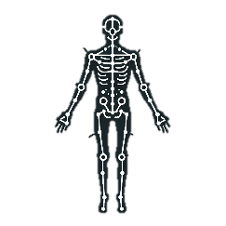


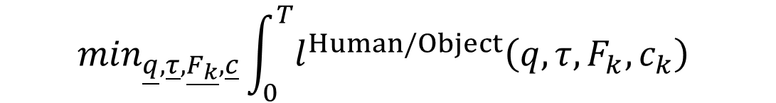
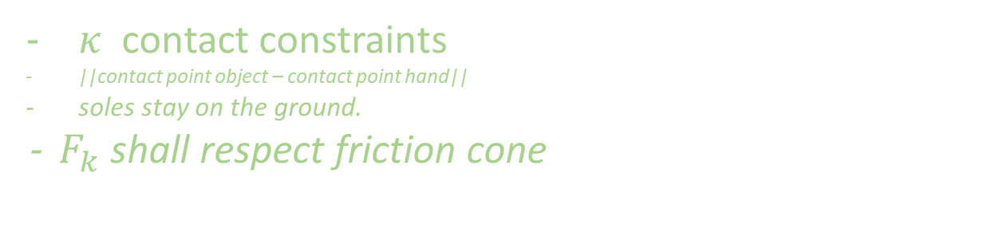


Estimating 3D Motion and Forces of Person-Object Interactions from Monocular Video
Reviewed by Matthieu Dinot, Balthazar Neveu
Original paper’s approach
Our work
Goal: reconstruct 3D motion, body torques and contact forces
from non-stereo videos in the wild without motion capture
→ in order to do behavior cloning on robots
Simplifications: Arm model, No objets, Static calibrated camera
Vision
Vision
CONTACT
DETECTION
ResNet
2D POSE
ESTIMATION
OpenPose
RGB FRAMES
OBJECT DETECTION
Mask R-CNN
3D POSE ESTIMATION
HMR
RGB FRAMES
2D & 3D POSE
ESTIMATION
MediaPipe
Fine-tuned
Off the shelf
Fine-tuned
Off the shelf
Off the shelf
CONTACT POINTS
2D POSITIONS
OPTIMIZER
MASKS - BOUNDING BOXES
3D JOINTS POSITIONS
3D POSITIONS
Optimizer
Initialization
2D POSITIONS
$$\min_{\underline{q},\underline{τ},\underline{F_{k}}, \underline{c}}\int_{0}^{T}{l^{Human/Object}\left(q,τ,F_{k},c_{k}\right) }$$
Subject to
Fully body dynamics constraints ($q , τ,{ F}_{k})$
Contact motion model $κ(q,c_{k})$
${ F}_{k}∈ℱ$ ($ℱ$: force model)
PROTOTYPE
Use inverse kinematics on the Mediapipe 3D arm positions (normalized arm lengths)
Optimize over States, Torques , Forces, Contacts
$κ$ contact constraints
||contact point object – contact point hand||
soles stay on the ground.
- ${ F}_{k}$ shall respect friction cone
Physics plausability
Relaxed dynamics constraints
Motion priors
Data fidelity terms
Camera intrinsics and extrinsics
Computed with finite differences
Optimizer
2D reprojection error
Linear velocities
Linear accelerations
$${l= l}_{3D}+l_{2D}+l_{torque}+l_{smooth}$$
Error on 3D points
negative log likelihood of the pose
Torque norm
Evaluation
Limitations, questions and difficulties
Vicon?
+ Pressure sensor
Parkour dataset
- How accurate are the estimated torques?
- Difficulty for the benchmark
- Multiple staged pipeline with inter-dependancies.
Why not re-injecting the estimated
poses and torques into a simulator?
1 ResNet per
4 github projects
Detector performances

